Slide 1

Map

Slide 2
Recap
More about functions
How do we make a simple grid
Discussed all things that were unclear

Slide 3
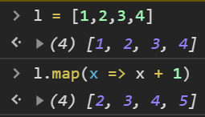
Example map
What is a Map function?
Similair to foreach
Implemented function in most languages

Slide 4
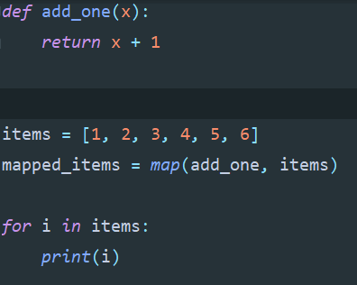
Example map
What is a Map function?
Similair to foreach
Implemented function in most languages

Slide 5
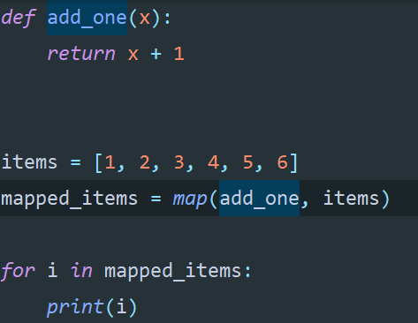
Example map

Slide 6
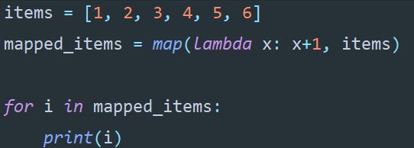
Example map

Slide 7
Summary
Map
Filter

